Slide 1
DL Assignment 1 – Food Image Classification

Slide 2
Table of Content
Overview
Data Preprocessing & Loading
Model Development
Model Evaluation
Model Application on Real Life Image
Summary

Slide 3
1.
Overview
Problem, Objective & Approach

Slide 4
Overview
Objective
Build an image classification model to classify 10 different food
Problems
Need a feasible approach
Misclasify food that looks the same
No “one size fits all” model available

Slide 5
Overview
Approach
Follow universal workflow of machine learning
Build 1 model from scratch
Develop another model with pretrained components
Compare models

Slide 6
2.
Data Preprocessing & Loading
Data Preparation

Slide 7
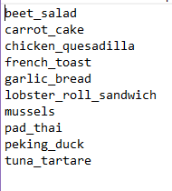
The Dataset
Original dataset had 101,000 images of 101 different food
Assigned to work with 10 food only
Bread base food is a concern

Slide 8
The Dataset
Each food has:
750 training
200 validation
50 test
Total images = (750 + 200 + 50) * 10
= 10000 images

Slide 9
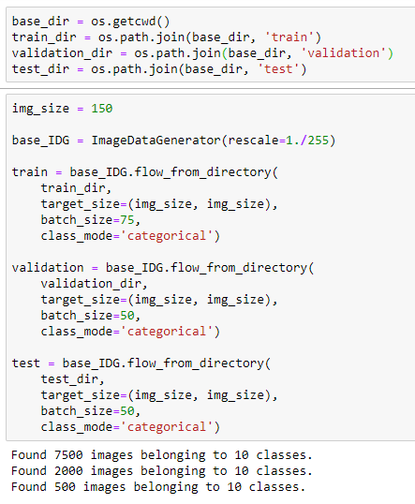
The Preprocessing & Loading
Used Image Data Generator to:
Resize 150px by 150px images
Rescaled pixel value
Pack data into batches

Slide 10
3.
Model Training
Problem, Objective & Approach

Slide 11
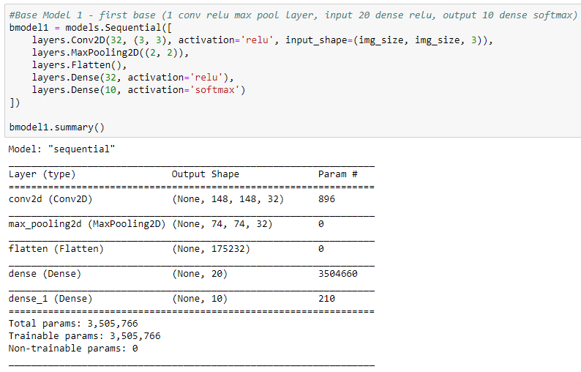
CNN made from scratch
Starting out with simple base
Components of CNN models:
Convolution + Relu
Max Pooling
Flatten
Dense Input layer (Relu)
Dense Output layer (Softmax)

Slide 12
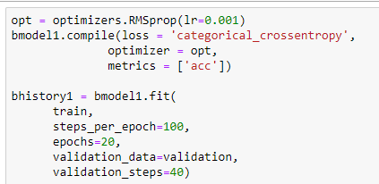
Base model 1
Compiling:
Categorical Crossentropy
RMSprop
Accuracy
Fitting:
20 training epochs
Steps per epoch based on batch size

Slide 13
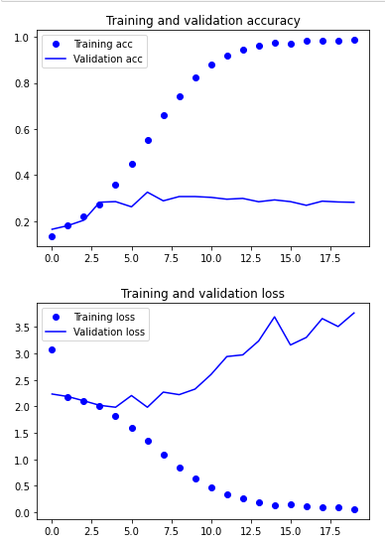
Base model 1
Result:
Overfit after 3rd epoch
Validation Acc ~28-30%
Action:
Add 1 more Conv2d layer + Max Pooling layer
Extend training epochs

Slide 14
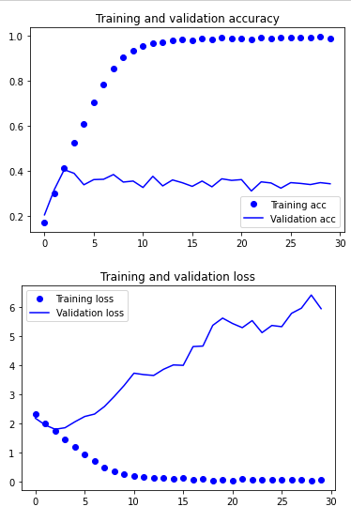
Base model 2 : Added Conv Layer
Result:
Still overfitting early
Validation Acc ~35%, Peaked 40%
Action:
Data Augmentation
Extend training epochs

Slide 15
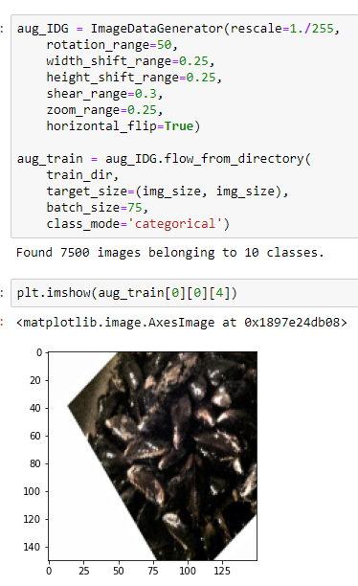
Data Augmentation
Used Image Data Generator again:
Specified modification range
Retained 150 by 150 image size
Retained rescaling of pixel value
Pack into same batch size as training data

Slide 16
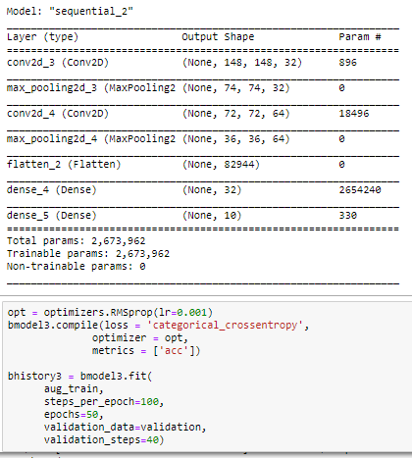
Base model 3 : Augmented Data
Changes:
Fitted with augmented data
Increased training epochs

Slide 17
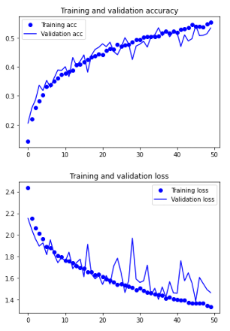
Base model 3 : Augmented Data
Result:
No longer overfits
Validation Acc peaked 53%
Action:
Massive scale up
Slower learning rate
More training epochs

Slide 18
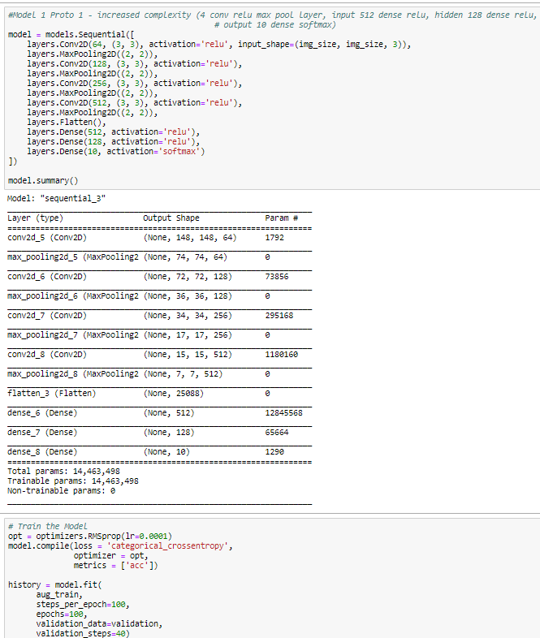
Prototype 1 – Scale Up
Changes:
Additional conv2d layer
Additional max pooling
Wider dense input layer
Additional 1 hidden layer
Slower learning rate
Additional training epochs

Slide 19
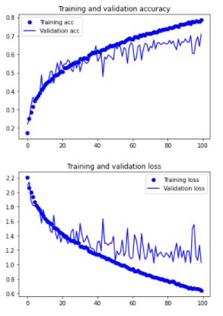
Prototype 1 – Scale Up
Result:
Overfitting after epoch 40
Validation Acc ~65%, peaked 70%
Action:
Try another design approach
Stacking conv2d before max pooling

Slide 20
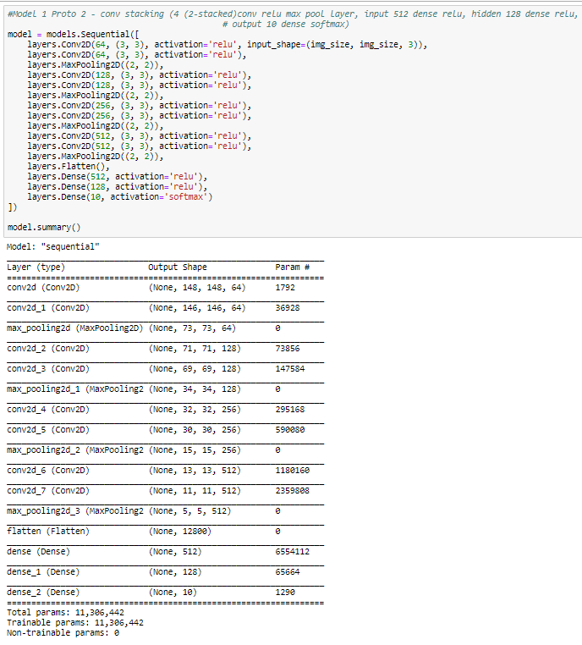
Prototype 2 – Stacking Conv2d
Changes:
Stacking extra conv2 layer before max pooling
Lesser trainable parameters

Slide 21
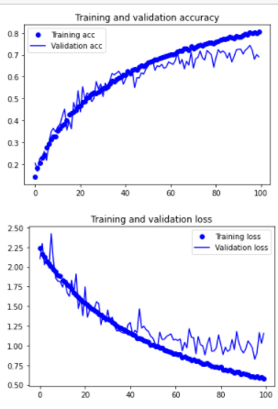
Prototype 2 – Stacking Conv2d
Result:
Overfitting delayed
Variance in loss is smaller
Validation Acc ~68%, peaked 75%
Action:
Deploy Dropout Layers

Slide 22
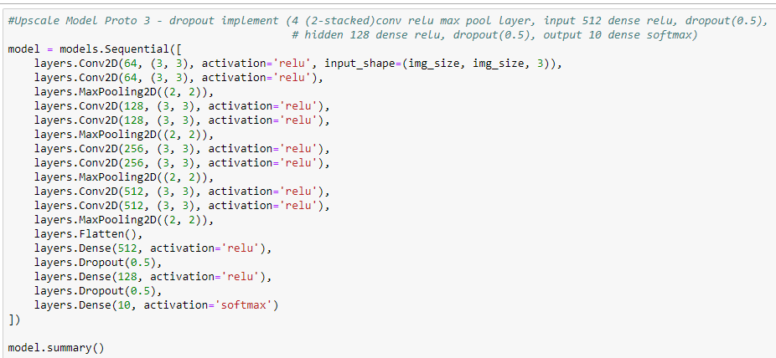
Prototype 3 – Dropout
Changes:
Added Dropout(0.5)

Slide 23
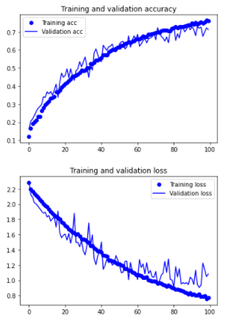
Prototype 3 – Dropout
Result:
Overfitting reduced from 10% to 5% at 100th epoch
Validation Acc ~68-70%
Action:
Deploy L2 Regularization

Slide 24
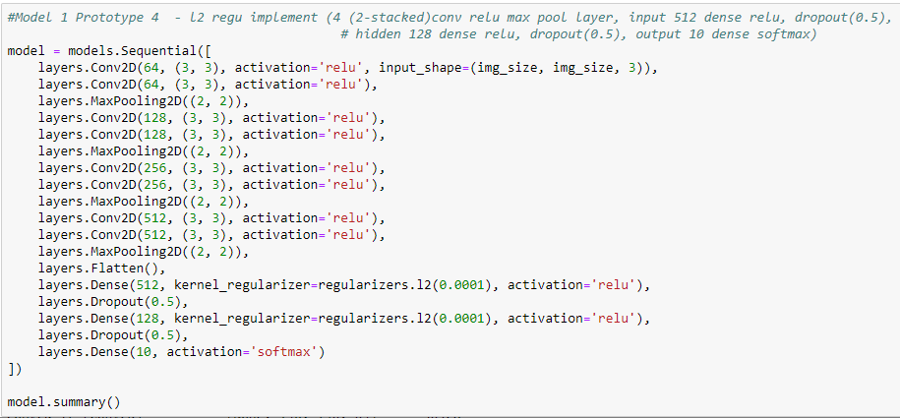
Prototype 4 – L2 Regularization
Changes:
Added L2 Regularizer

Slide 25
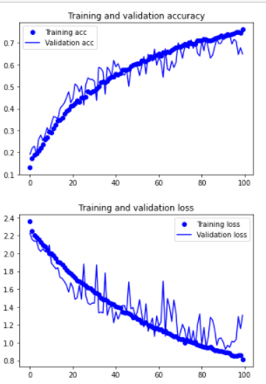
Prototype 4 – L2 Regularization
Result:
Validation Acc on a very bad note
Increased variance for validation loss
Validation Acc ~69-70%
Action:
Try another Optimizer

Slide 26
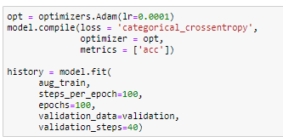
Prototype 5 – Adam Optimizer
Changes:
Replaced RMSprop with Adam

Slide 27
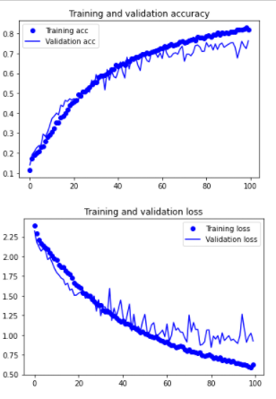
Prototype 5 – Adam Optimizer
Result:
More controlled variance for validation loss
Action:
Early stopping at 60th epoch

Slide 28
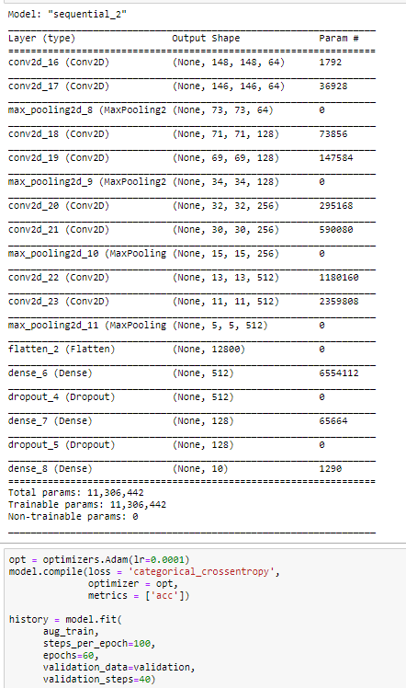
Final Model 1 – Early Stopping at epoch 60
Changes:
Training epochs at 60
Final trainable parameters: ~11.3 million

Slide 29
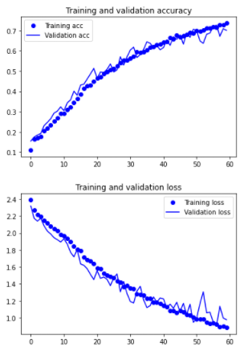
Final Model 1 – Early Stopping at epoch 60
Result by 60th epoch:
Training Acc =73.65%
Validation Acc = 70.05%
Action:
Saved model as ‘food_model_1.h5’

Slide 30
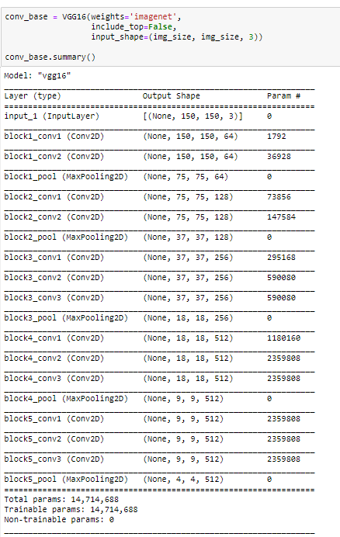
Pretrained models
Working with pretrained models:
Download model with imagenet weights as conv_base
Connect conv_base to dense network to make predictions
Freeze conv_base

Slide 31
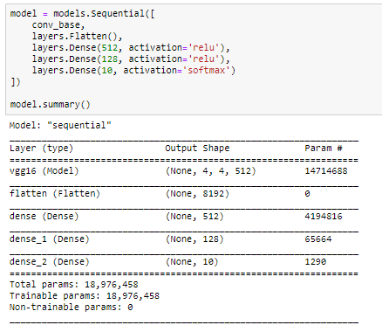
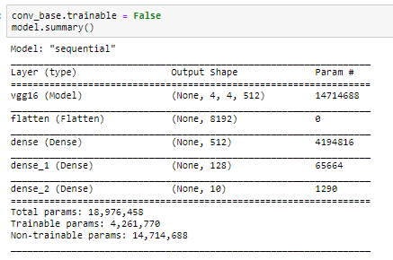
VGG16 – Feature extraction with Data Augmentation

Slide 32
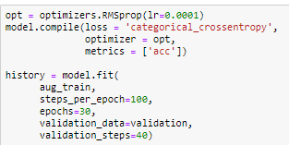
VGG16 – Feature extraction with Data Augmentation
Compiling:
Categorical Crossentropy
RMSprop
Accuracy
Fitting:
30 training epochs
Steps per epoch based on batch size

Slide 33
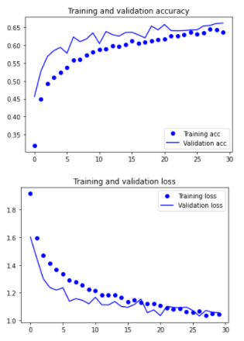
VGG16 – Feature extraction with Data Augmentation
Result:
Seems to be learning well but underfitted
Validation Acc ~60%
Action:
Try Fine Tuning

Slide 34
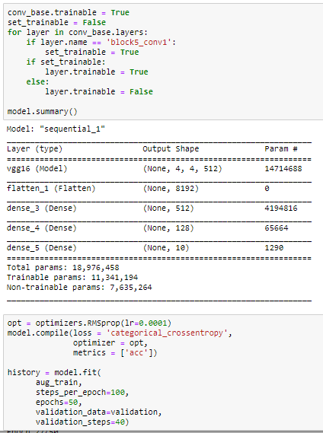
VGG16 – Fine Tuning
Changes:
Freeze every layer of conv_base except for last block

Slide 35
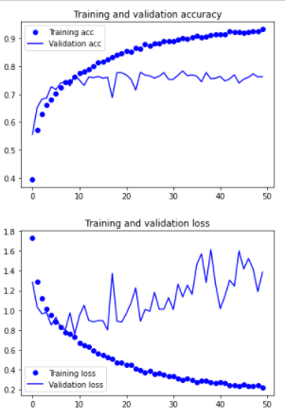
VGG16 – Fine Tuning
Result:
Overfitted early on
Validation Acc ~74%
Action:
Deploy regularization techniques

Slide 36
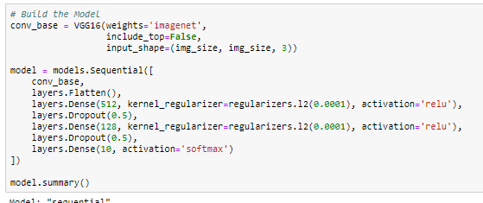
VGG16 – Fine Tuning with Regularization Techniques
Changes:
Added L2 Regularization
Added Dropout layers

Slide 37
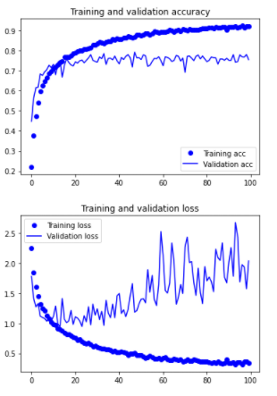
VGG16 – Fine Tuning with Regularization Techniques
Result:
Still overfitting early on
Validation Acc ~72%
Action:
Try another pretrained model

Slide 38
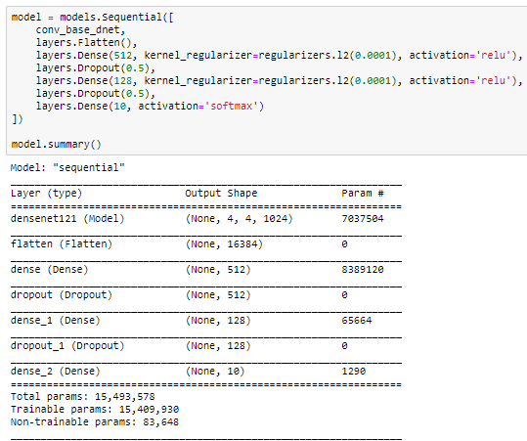
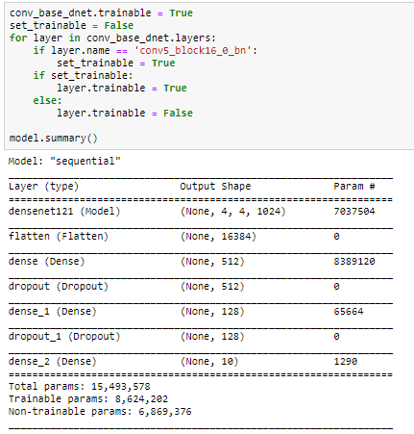
DenseNet121 – Fine Tuning with Regularization Techniques

Slide 39
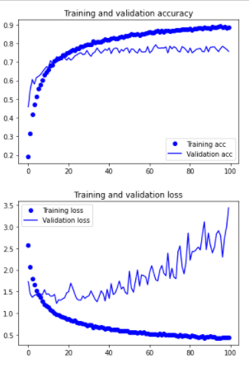
DenseNet121 – Fine Tuning with Regularization Techniques
Result:
Similar learning curve with VGG16
Validation Acc peaked 73% before overfitting
Action:
Trying Adam Optimizer

Slide 40
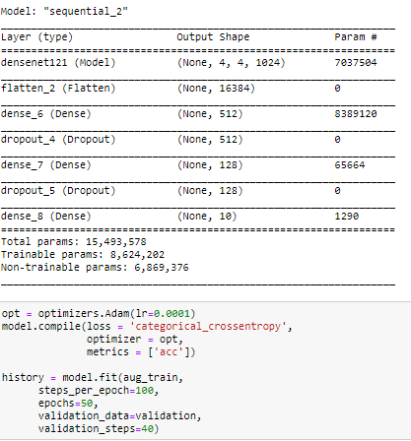
DenseNet121 – Adam Optimizer
Changes:
Replaced RMSprop with Adam

Slide 41
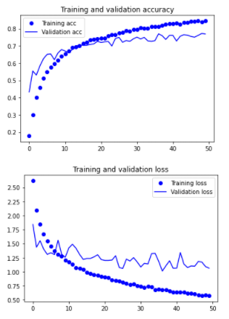
DenseNet121 – Adam Optimizer
Result:
More controlled variance for validation loss
Still overfitting early
Action:
Early stopping at 20th epoch

Slide 42
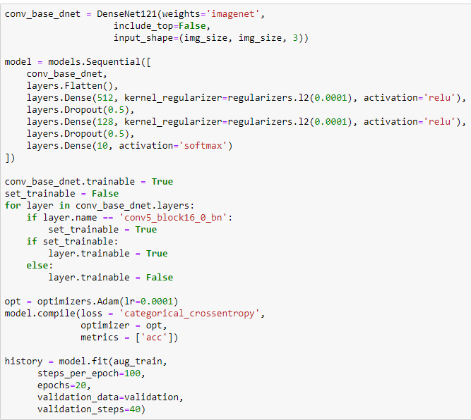
Final Model 2 – DenseNet121 Early Stopping at Epoch 20
Changes:
Training epochs at 20
Final trainable parameters: ~8.6 million

Slide 43
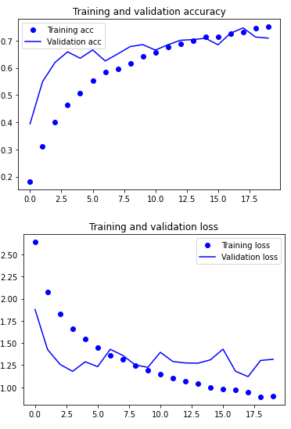
Final Model 2 – DenseNet121 Early Stopping at Epoch 20
Result by 20th epoch:
Training Acc =75.05%
Validation Acc = 70.9%
Action:
Saved model as ‘food_model_2.h5’

Slide 44
4.
Model Evaluation
Test Accuracy, Confusion Matrix & Classification Report

Slide 45
Test Accuracy
Accuracy | Model 1 | Model 2
Training | 73.65% | 75.05%
Validation | 70.05% | 70.9%
Test | 71% | 74.2%

Slide 46
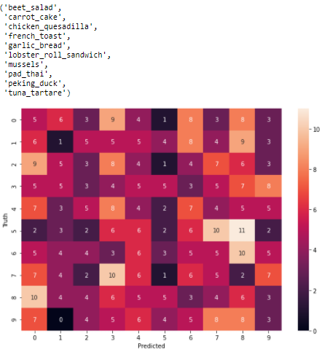
Model 1 – Confusion Matrix
Bad at classifying:
Carrot cake
Frequent miss in prediction:
Lobster roll or mussels as peking duck

Slide 47
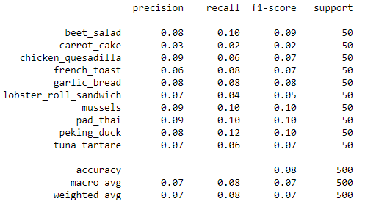
Model 1 – Classification Report
Summary:
Performance in predicting are even except for carrot cake and lobster roll

Slide 48
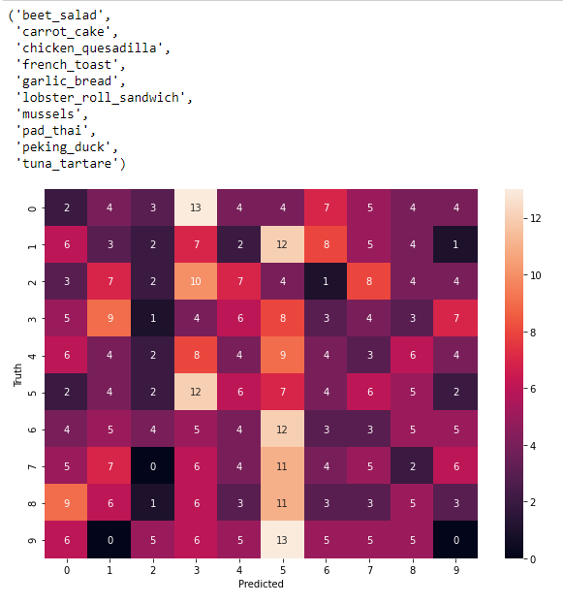
Model 2 – Confusion Matrix
Bad at classifying:
Tuna Tartare (0 correct)
Frequent miss in prediction with:
French toast
Lobster roll

Slide 49
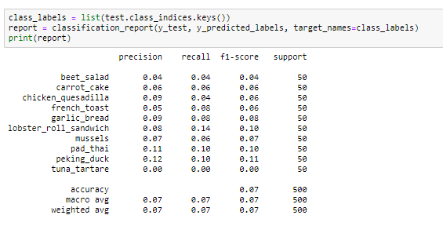
Model 2 – Classification Report
Summary:
The prediction are much worser than model 1
Tuna Tartare scoring 0 hurts model 2 chances of being best model

Slide 50
Best model verdict
Best model = model 1
Model 2 poor performance despite high test accuracy discourage me from picking it
Model 1 is more well balanced with a slight trade off in test accuracy

Slide 51
5.
Model Application on Real Life Image
Putting it to the test

Slide 52
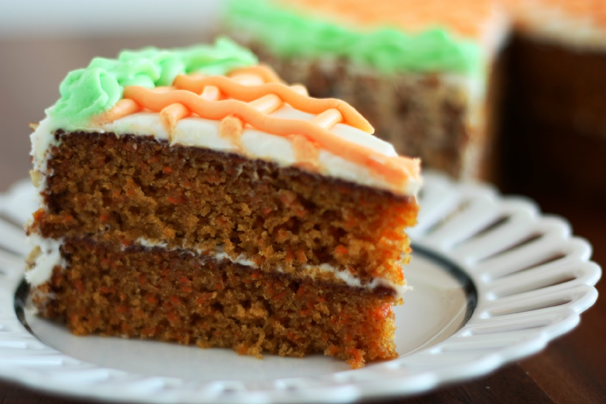
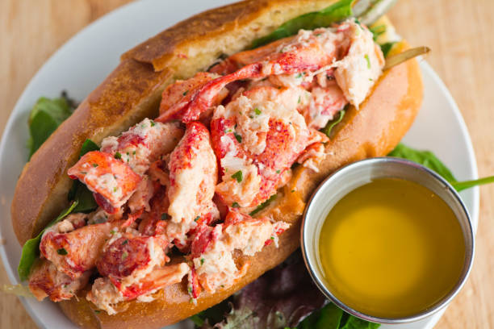
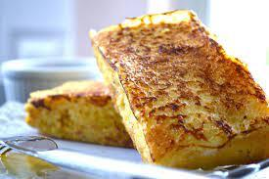
Chosen Picture
Model 1 is bad with:
Carrot Cake
Lobster Roll
Test with bread-based food:
French toast

Slide 53
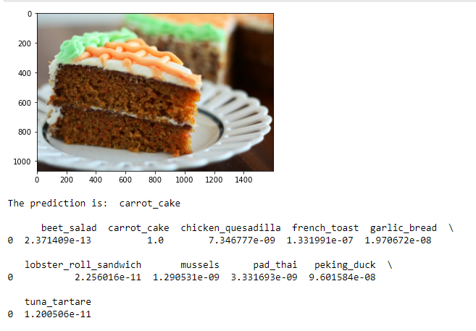
Chosen Picture – Carrot Cake

Slide 54
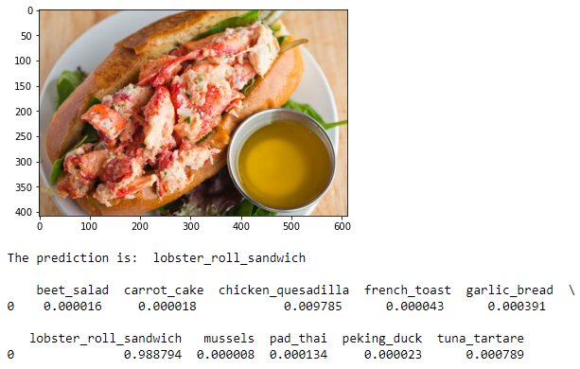
Chosen Picture – Lobster Roll

Slide 55
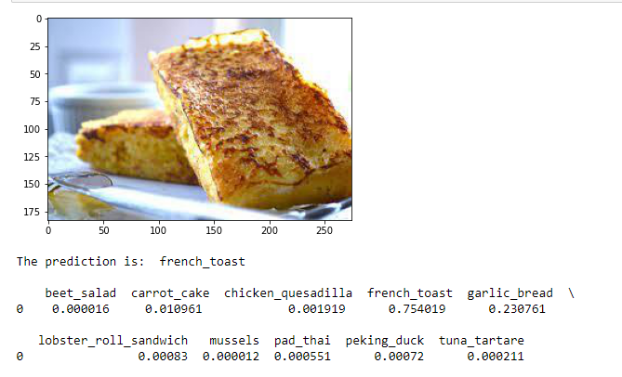
Chosen Picture – French Toast

Slide 56
6.
Summary

Slide 57
Results
Best model was model 1
Even though, it scored lesser test accuracy
Model 1 was still able to successfully work with real life images.

Slide 58
Improvement
I think I can:
Research into approaches used in Kaggle competition
Designed a better model from scratch with more experience
I intend to attempt this project with a different approach in the future

Slide 59
Thanks!

